Slide 1

INTRODUCTION TO TIME SERIES FORECASTING
SANDEEP PAWAR
AUGUST 16, 2020
www.PawarBI.com
https://www.linkedin.com/in/sanpawar/

Slide 2
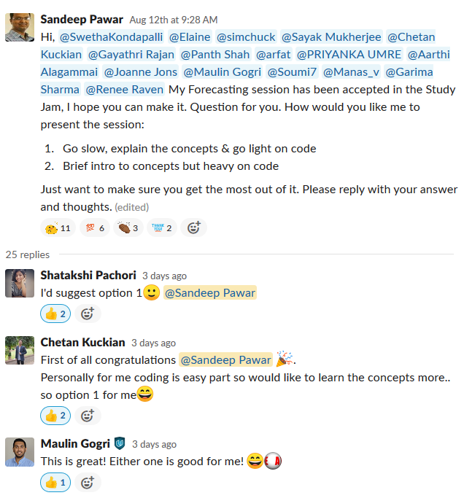
INTRODUCTION TO TIME SERIES FORECASTING
Agenda
Go Slow
Explain the Concepts
Some code (Python)

Slide 3
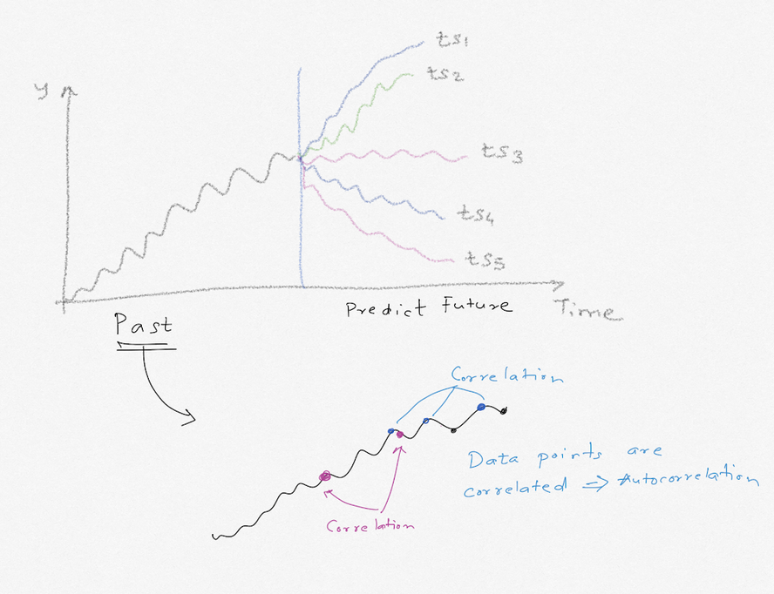
TIME SERIES FORECASTING
Time Series Forecasting:
Predict the future, given the past
Classical Forecasting vs ML
Autocorrelation
Fixed intervals
Repeatable / observables patterns
White/Gray vs. Black Box
Classical Forecasting:
Statistical Methods
Holt Winters, ETS, SARIMA, VAR
Applications:
Sales Forecasting
Weather forecasts
Demand Prediction / Uncertainty
Sensor Data, signal processing etc.

Slide 4
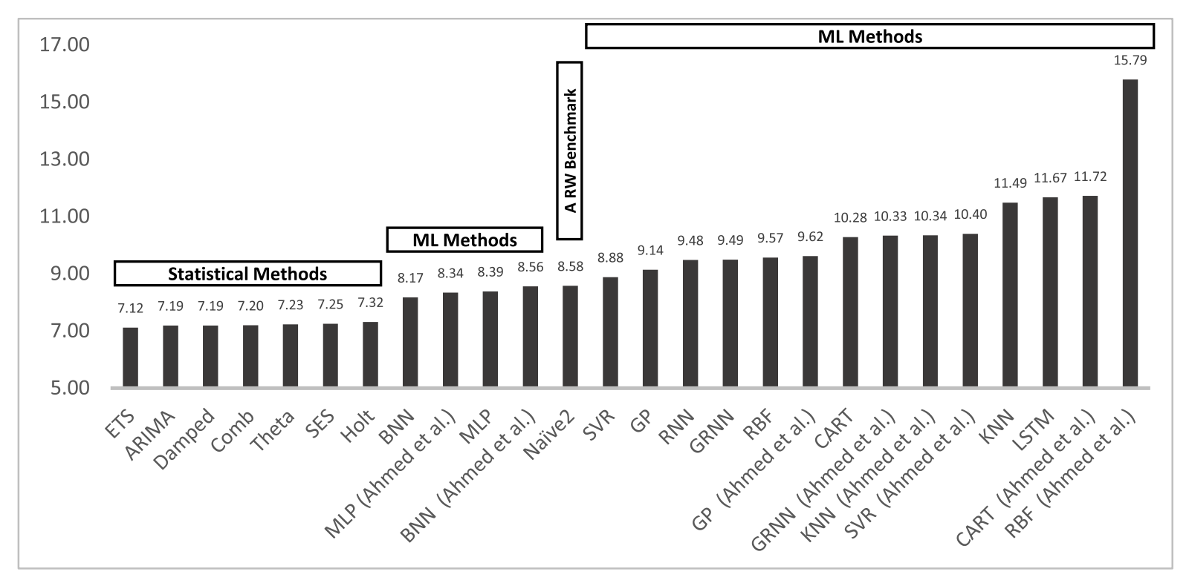
WHY CLASSICAL METHODS?
M3 Competition
Reference: http://www.forecastingprinciples.com/paperpdf/Makridakia-The%20M3%20Competition.pdf

Slide 5
TIME SERIES FORECASTING
Foundational concepts of time series analysis
Stochastic Process View
Temporal Structure / Behavior:
Trend / Seasonality / Cyclic
Stationary vs Non-Stationary
Autocorrelation, partial-autocorrelation

Slide 6
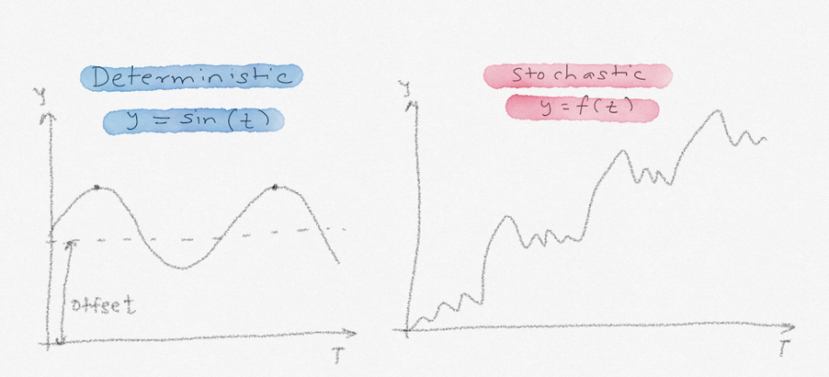
STOCHASTIC PROCESS
Stochastic => Probabilistic
Model that describes the probability structure of a sequence of observations
To make a forecasts is to infer the probability distribution of a future observations from the population, given the past values

Slide 7
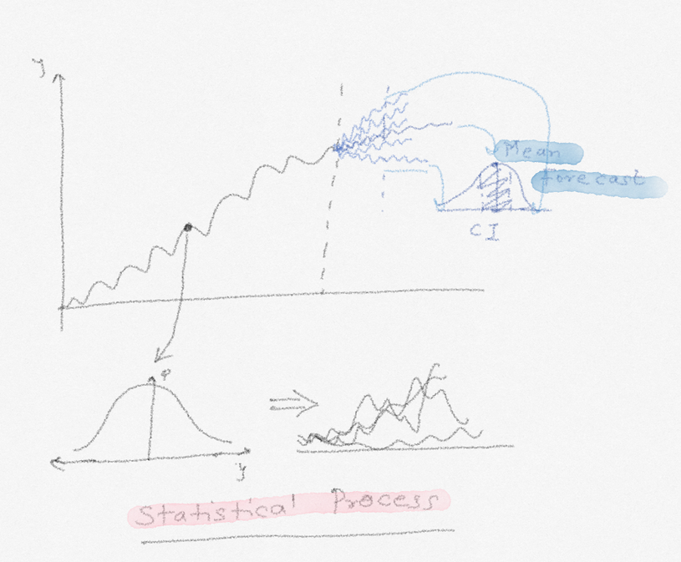
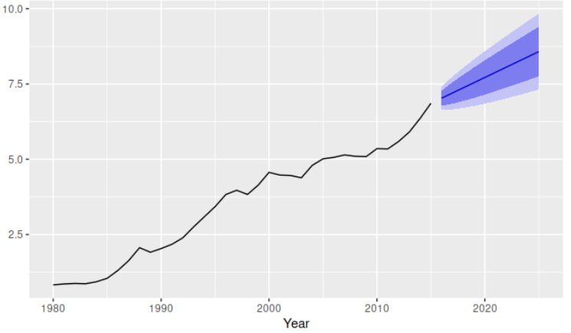
STOCHASTIC PROCESS
Statistical Realization => Probability, i.e. Uncertainty
Implication is that always keep in mind that when a point forecast is obtained, there is always some uncertainty around it. We capture that uncertainty by calculating prediction interval/confidence interval
What’s the goal of the forecast?
Accurate Forecast
Reduced Uncertainty
Both
M5 Competition

Slide 8
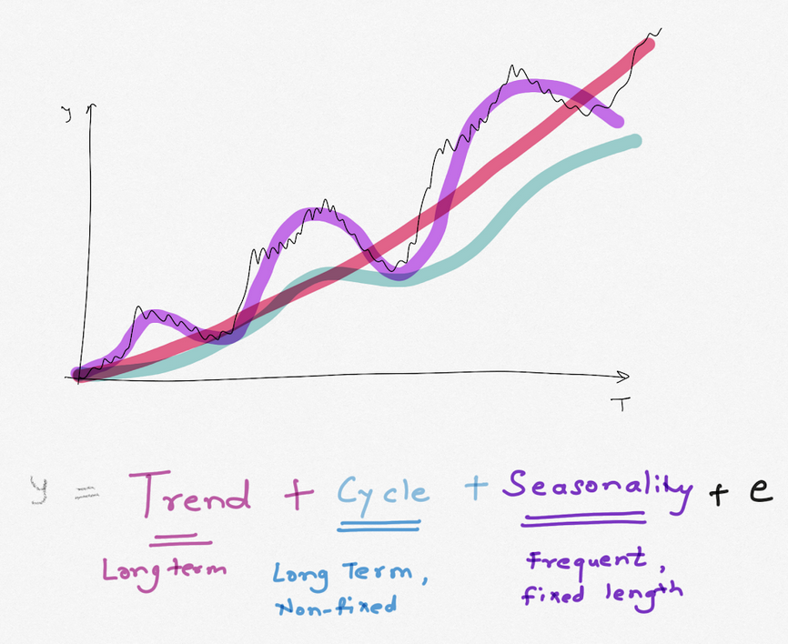
TIME SERIES DECOMPOSITION
Trend: Avg variation between consecutive time periods, long –term direction
Seasonality : Change with fixed, known frequency
Cyclic : Change with variable frequency

Slide 9
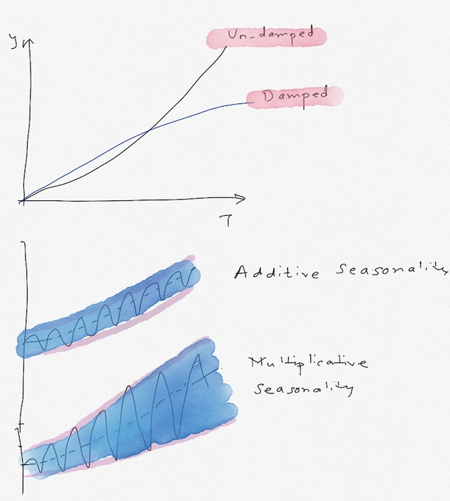
TREND & SEASONALITY
Un-damped vs Damped Trend
Based on the amplitude of the seasonal variation, seasonality can be described as
Additive: From one season to the next, change can be defined in terms of +/- compared to the average
Multiplicative: From one season to the next, change can be defined in terms of % compared to the average
Mixed
Reference: https://kourentzes.com/forecasting/2014/11/09/additive-and-multiplicative-seasonality/

Slide 10
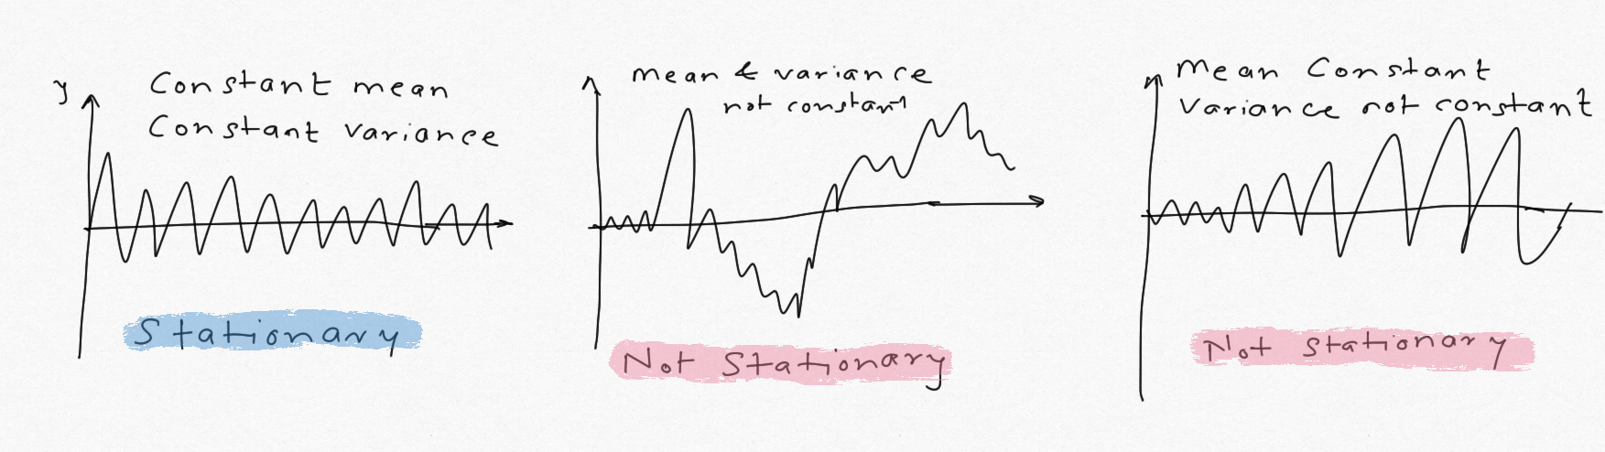
STATIONARY VS. NON-STATIONARY
Stationary Time Series: Constant mean & constant variance
0 mean, constant variance: White Noise
Non-stationary Time Series : Non constant mean &/or non constant variance
Implication : SARIMA needs stationary time series, ETS does not
How to check: Dicky-Fuller Test, ACF plots, Ljung Box
How to make series stationary? Differencing, filtering (moving avg, mean differencing)

Slide 11
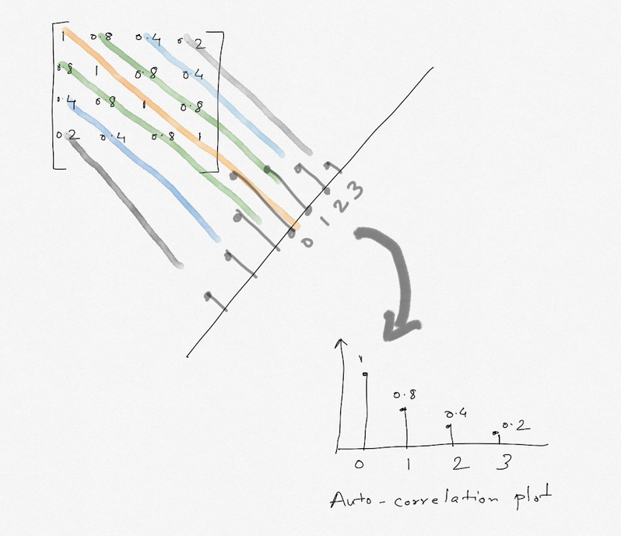
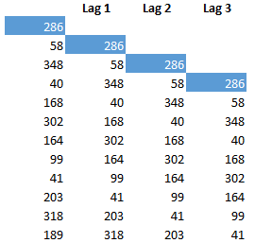
AUTO-CORRELATION
Auto-correlation:
Correlation with its own past (e.g. bike share)
If the auto-correlation (ACF) is low*:
Stationary time series
How many lags : ~N/4, at least
Temporal Behavior:
Strength (seasonality)
Direction
Trend
Momentum (Gradual vs Rapid)
Link

Slide 12
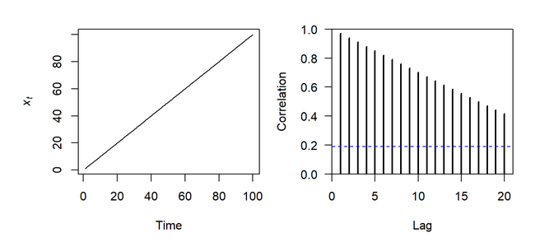
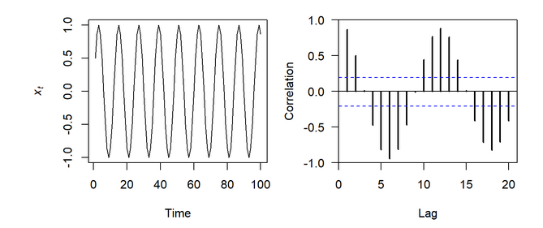
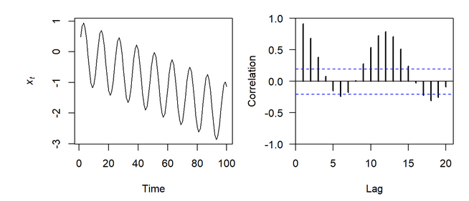
AUTO-CORRELATION
ACF gradually decreasing
-> Trend
ACF Alternating/Scalloping & Fixed Pattern
-> Seasonality
Find Peaks for seasonality
ACF Alternating & Variable Pattern, gradually decreasing
-> Seasonality & Trend
Mean-reversion?
Also helps identify MA(q) process
Partial-Auto Correlation (PACF): ACF controlling for lower order lags (AR(p) process)
Reference: https://nwfsc-timeseries.github.io/atsa-labs/sec-tslab-correlation-within-and-among-time-series.html

Slide 13
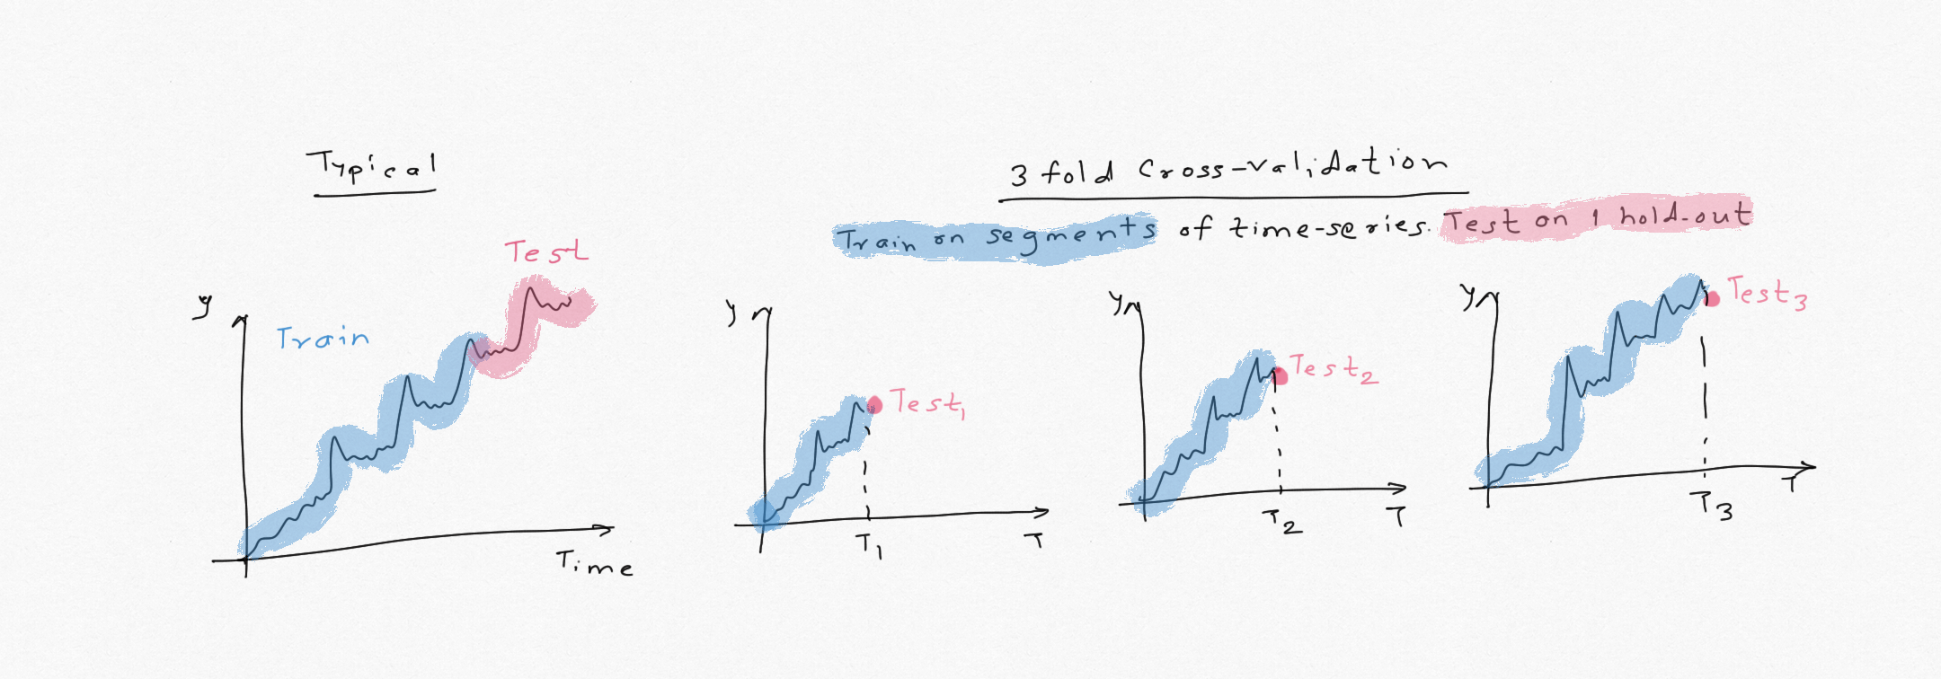
SPLITTING THE DATA
Data cannot be split randomly to keep auto-correlation and temporal structure
Test size ≥ Forecast Horizon, e.g. forecast is 12 months, test 12-16 months
Sliding vs. Expanding window cross-validation

Slide 14
TIME SERIES EDA STEPS
Split the data
Plot the data
Series, sub-series plots
Are there any missing values? ‘ffill’, ‘bfill’, moving avg
Distribution skewed/symmetric? [implication: transformation]
Are there any outliers ? [implications: method, error metric]
Stationary or non-stationary? [implications: HW,ETS,SARIMA]
Seasonal or non-seasonal ?
Additive, Multiplicative, Mixed? [implications: ETS, transformation]
Fixed or Variable [ETS/SARIMA, TBATS, ML]
Trend ?
Damped, Un-damped ? [HW,ETS]
Exogenous variables ? [implications: SARIMAX, ML]
Intermittent or continuous [implications: transformation, Classical vs ML]
Describe the time series in words
Pawarbi.com

Slide 15
CLASSICAL FORECASTING METHODS
Seasonal Naïve: Forecast = Recent Observations
Holt-Winter’s Method (Triple Exponential Smoothing)
Error Trend Seasonality (ETS) (Exponential Smoothing)
SARIMAX : Seasonal Auto-Regressive, Integrated, Moving Avg, Exog.

Slide 16
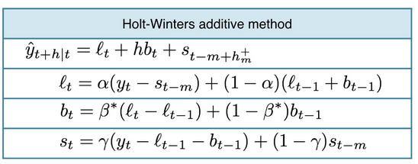
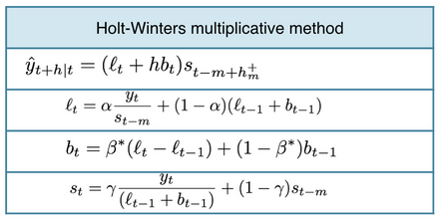
EXPONENTIAL SMOOTHING
Exponential weights are given to past observations to predict future
Forecast = (α * recent) + [(α *(1- α) *(recent-1)] + [(α *(1- α)² *(recent-2)]
High weight (α): More weight to recent observation
Low weight : More weight to past observations
Just like Linear Regression, α is calculated by minimizing SSE
Same concept is applied to trend & seasonality

Slide 17
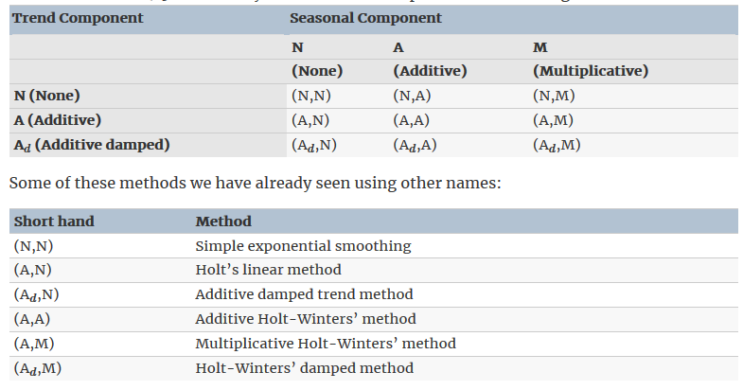
EXPONENTIAL SMOOTHING
ETS Nomenclature: ETS(A,A,A)
Error: A,M
Trend: N, A, Ad
Seasonal: N,A,M
Reference: https://otexts.com/fpp2/taxonomy.html

Slide 18
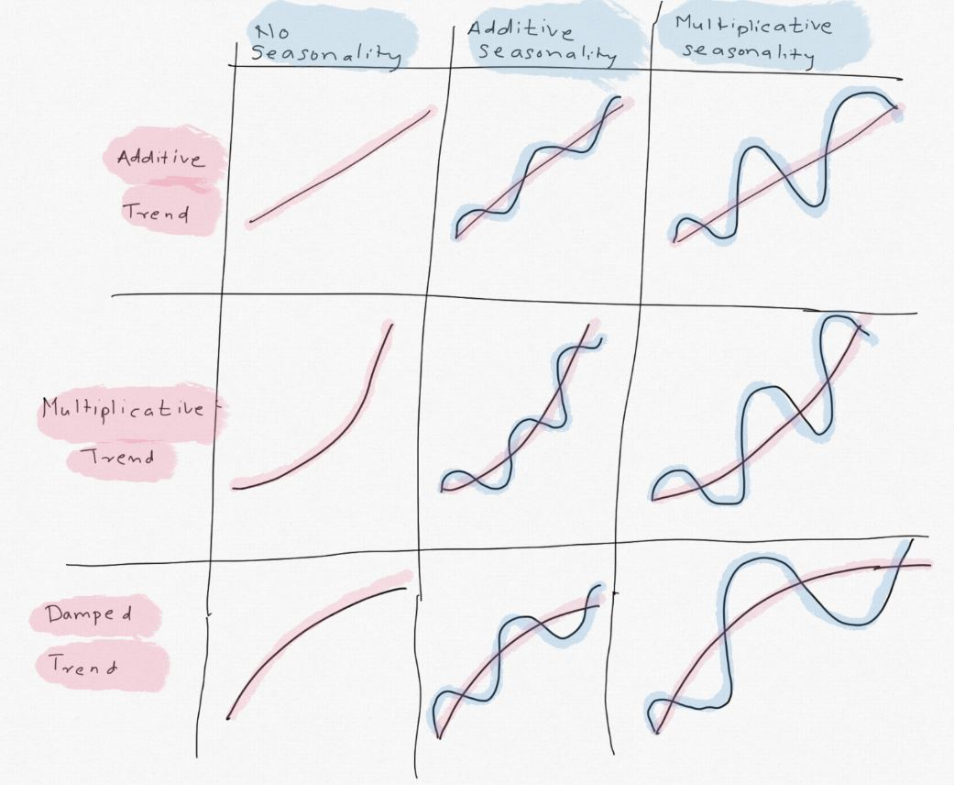
EXPONENTIAL SMOOTHING

Slide 19
MODELING STEPS
Python: Statsmodels.tsa.statespace
R: ETS, forecast(),fable()
Steps:
Train/test
EDA
Transformation
Forecast
Model Evaluation (RMSE, %MAPE, AIC)
Residual check: (Forecast error vs residuals)
If residuals are not stationary=> not a good fit
If residuals mean ≠ 0, biased forecast [remedy : add ‘b’ to all forecasts]
Variance constant & Gaussian : Affects P.I
Reference: https://otexts.com/fpp2/residuals.html

Slide 20
SARIMAX(p,d,q,P,D,Q)
S: Seasonal
AR(p,P): Auto-Regressive
AR process: Regression on past values
Use PACF to find p
MA(q,Q): Moving Avg
Weighted avg of the past errors
Use ACF
X: Exogenous
External variable such as temperature, geography, inflation etc.
p+d+q+P+D+Q <= 6
AR (p) is more common than MA(q)
Use Auto.ARIMA (R) or pmdARIMA (Python) to find order of the SARIMA process

Slide 21
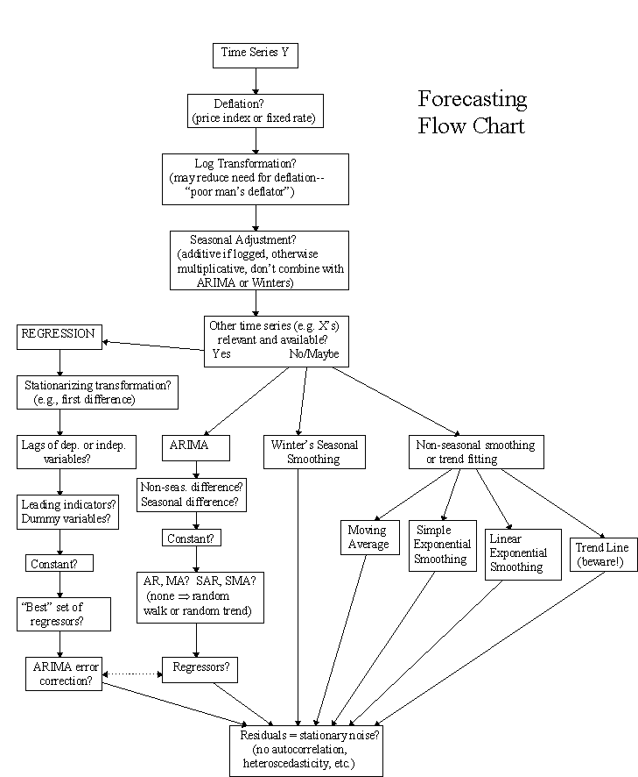
METHOD SELECTION
Reference: https://people.duke.edu/~rnau/411home.htm

Slide 22
When to Use ML
Time series is influenced by several external variables
High frequency, high granularity
Non-continuous, intermittent data
Highly non-linear behavior and interaction effects
Hierarchical time series

